Slide 1
Chem-Trend + You
QUALITY. PRODUCTIVITY. SUSTAINABILITY.

Slide 2

CHEM-trend fundamentals
History
Vision/
mission
Values
Culture
PEOPLE
Field of
business
Business
model

Slide 3
Chem-Trend History
1960
Chem-Trend founded by Peer Lorentzen with a custom release agent for the polyurethane molding industry.
1988
Chem-Trend sold to Burmah Castrol plc.
Ownership
2000
BP Amoco purchased share capital of Burmah Castrol, including Chem-Trend.
2001
BP sold its release agents business to Cinven, a leading private equity provider.
2004
Freudenberg acquired
Chem-Trend from Cinven, placing it in the FCS
Business Group.

Slide 4
Chem-Trend History
1960s
Started with innovative polyurethane release agents and water-based die lubricants.
1970s
Expanded into rubber molding with semi-permanent release agent technology.
Markets
1990s
Continued diversification into tire and composite industries.
2000s
Entered thermoplastic and wood composite markets as global expansion continues.

Slide 5
Chem-Trend History
1960
Chem-Trend founded in Howell, MI.
1970s
Operations and sales offices across Europe, including a legal entity in France.
1980s
Global Presence
Operations in Brazil, Mexico and Korea,
as well as a legal entity in
the U.K.
1990s
Operations in Germany and Australia. Legal entities in Italy, Singapore, China and India.
2000s
Continued expansion across Europe and Asia, including legal entities in Poland and Thailand, and operations in China.
2010s
New sites, including operations in India and Brazil; R&D in China, India and Brazil; legal entities in Japan, Vietnam and Romania.

Slide 6
VIsion
To be the world’s leading provider of value adding process chemical specialties, delivered by a diverse and inclusive organization, passionate about providing customers with innovative and sustainable solutions.

Slide 7
Mission
We are a global, customer-centric company, providing
the industry with premium release agents, purging
compounds and other process chemical specialties with world-class service and a sense of urgency.
Our people create value by improving customers’ productivity, quality and sustainability. We follow our core values and guiding principles.

Slide 8
Field of business
CHEMICAL
SPECIALTIES
PROCESS CHEMICAL
SPECIALTIES
PROCESS CHEMICALS
Examples:
Adhesives
Coatings
Lubricants
Greases
Examples:
Metalworking fluids
Etching agents
Cleaners
Tool & mold sealers
Examples:
High Performance:
Release agents
Purging compounds
Cleaners

Slide 9

business MODEL
Maintenance • Purchasing • HR • Quality • Regulatory • SCM • Administration • Engineering • Finance • HSE • IT • Logistics • Manufacturing •
Develop an Intimate Understanding
of the Customer’s Needs
Sales / Customer & Technical Service
Define Value and
Deliver Service
Sales / Customer & Technical Service
Identify or Develop
Differentiated Products
M&T/Sales
Customer
Relationship
CONFIDENTIAL

Slide 10



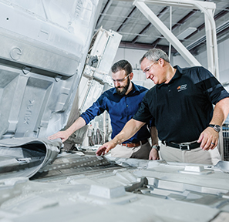

values
C
Customer
Driven
We strive to exceed
customer expectations.
H
Hard
Working
We work hard while observing
diversity, respect and ethics.
E
Ethical
We endorse professional
principles and practices.
M
Motivated
We accept today’s and
tomorrow’s challenges.
T
Teamwork
We empower our people. Everyone’s commitment
is essential.
R
Responsive
We respond with a sense
of urgency.
E
Environmentally
Responsible
“We all take care” about the environment, health and safety.
N
Non-Stop Improvement
We continuously innovate
and improve our product technology, operation
efficiency and service.
D
Dedicated
We work with drive
and passion.
FREUDENBERG CODE OF CONDUCT
FREUDENBERG GUIDING PRINCIPLES

Slide 11

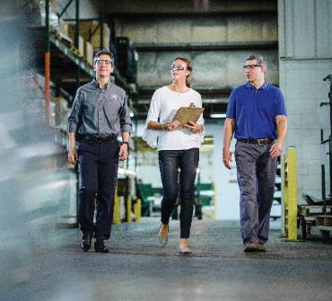
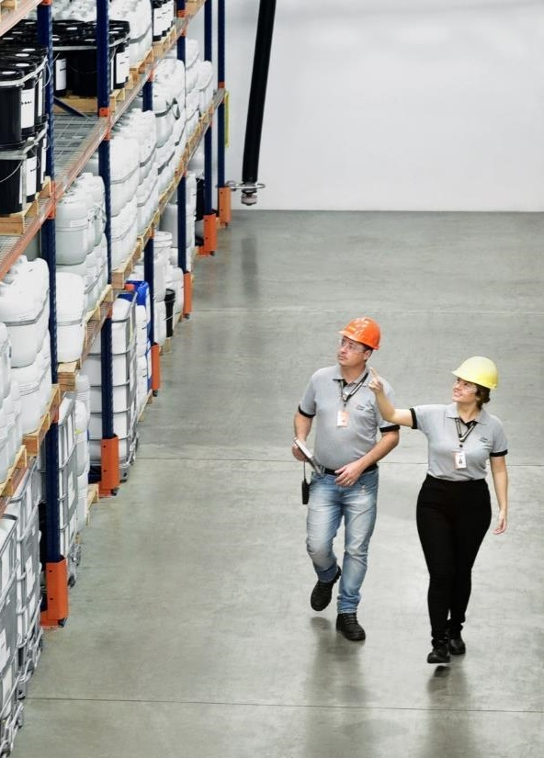
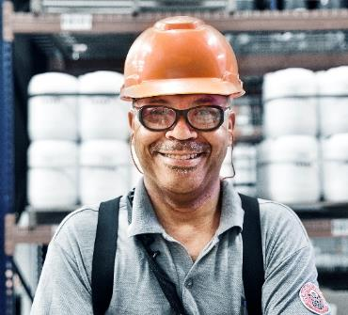
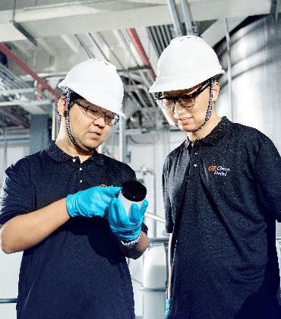

diversity
CHEM-TREND IS FOR YOU.
diversity
11

Slide 12
CHEM-TREND IS FOR YOU
We embrace diversity celebrating our differences under a culture of openness and respect everywhere in the world.
We believe that an inclusive and engaging workplace, where everyone belongs, empowers you to achieve your best self.
We value creativity and teamwork, delivering innovation with successful results for us and for our customers.
Together!
12

Slide 13
CHEM-trend fundamentals
History
Vision/
mission
Summary
Values
Culture
PEOPLE
Field of
business
Business
model

Slide 14
Release Innovation™
Notes:
End

