Slide 1
QUALITY. PRODUCTIVITY. SUSTAINABILITY.

Slide 2
CHEM-trend fundamentals
History
Vision/
mission
Values
Culture
PEOPLE
Field of
business
Business
model

Slide 3
Chem-Trend History
1960
Chem-Trend founded by Peer Lorentzen with a custom release agent for the polyurethane molding industry.
1988
Chem-Trend sold to Burmah Castrol plc.
Ownership
2000
BP Amoco purchased share capital of Burmah Castrol, including Chem-Trend.
2001
BP sold its release agents business to Cinven, a leading private equity provider.
2004
Freudenberg acquired
Chem-Trend from Cinven, placing it in the FCS
Business Group.

Slide 4
Chem-Trend History
1960s
Started with innovative polyurethane release agents and water-based die lubricants.
1970s
Expanded into rubber molding with semi-permanent release agent technology.
Markets
1990s
Continued diversification into tire and composite industries.
2000s
Entered thermoplastic and wood composite markets as global expansion continues.

Slide 5
Chem-Trend History
1960
Chem-Trend founded in Howell, MI.
1970s
Operations and sales offices across Europe, including a legal entity in France.
1980s
Global Presence
Operations in Brazil, Mexico and Korea,
as well as a legal entity in
the U.K.
1990s
Operations in Germany and Australia. Legal entities in Italy, Singapore, China and India.
2000s
Continued expansion across Europe and Asia, including legal entities in Poland and Thailand, and operations in China.
2010s
New sites, including operations in India and Brazil; R&D in China, India and Brazil; legal entities in Japan, Vietnam and Romania.

Slide 6
VIsion
To be the world’s leading provider of value adding process chemical specialties, delivered by a diverse and inclusive organization, passionate about providing customers with innovative and sustainable solutions.

Slide 7
Mission
We are a global, customer-centric company, providing
the industry with premium release agents, purging
compounds and other process chemical specialties with world-class service and a sense of urgency.
Our people create value by improving customers’ productivity, quality and sustainability. We follow our core values and guiding principles.

Slide 8
Field of business
CHEMICAL
SPECIALTIES
PROCESS CHEMICAL
SPECIALTIES
PROCESS CHEMICALS
Examples:
Adhesives
Coatings
Lubricants
Greases
Examples:
Metalworking fluids
Etching agents
Cleaners
Tool & mold sealers
Examples:
High Performance:
Release agents
Purging compounds
Cleaners

Slide 9
business MODEL
Maintenance • Purchasing • HR • Quality • Regulatory • SCM • Administration • Engineering • Finance • HSE • IT • Logistics • Manufacturing •
Develop an Intimate Understanding
of the Customer’s Needs
Sales / Customer & Technical Service
Define Value and
Deliver Service
Sales / Customer & Technical Service
Identify or Develop
Differentiated Products
M&T/Sales
Customer
Relationship

Slide 10






values
C
Customer
Driven
We strive to exceed
customer expectations.
H
Hard
Working
We work hard while observing
diversity, respect and ethics.
E
Ethical
We endorse professional
principles and practices.
M
Motivated
We accept today’s and
tomorrow’s challenges.
T
Teamwork
We empower our people. Everyone’s commitment
is essential.
R
Responsive
We respond with a sense
of urgency.
E
Environmentally
Responsible
“We all take care” about the environment, health and safety.
N
Non-Stop Improvement
We continuously innovate
and improve our product technology, operation
efficiency and service.
D
Dedicated
We work with drive
and passion.
FREUDENBERG CODE OF CONDUCT
FREUDENBERG GUIDING PRINCIPLES

Slide 11
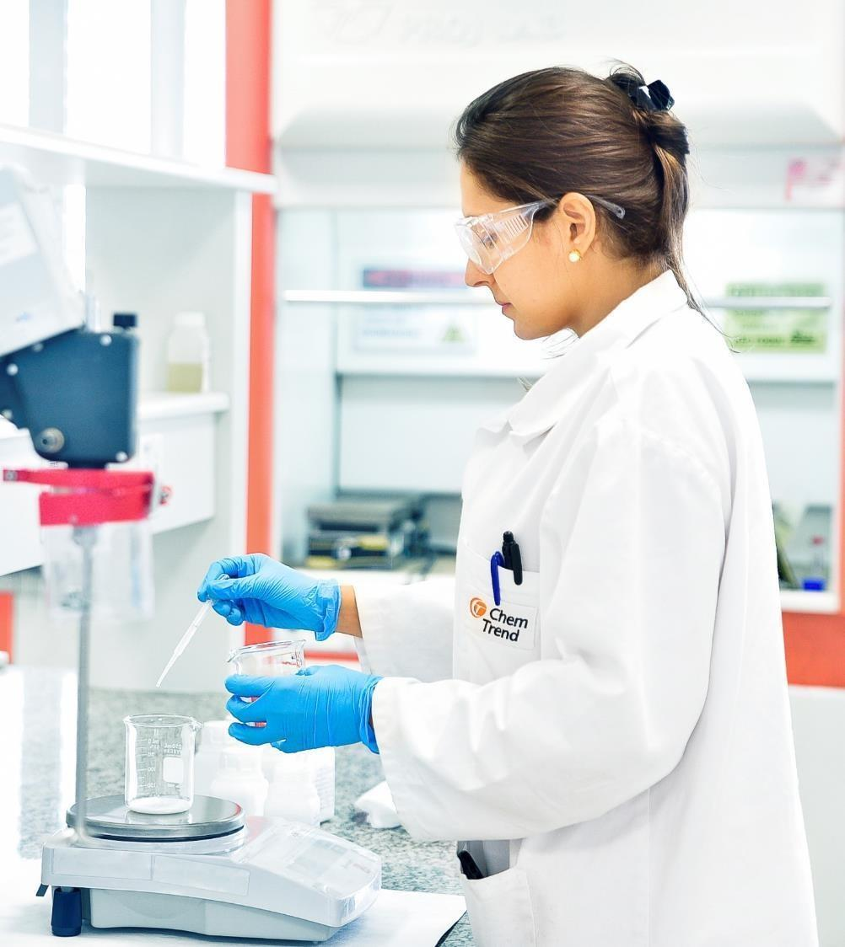
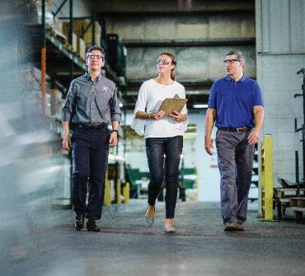
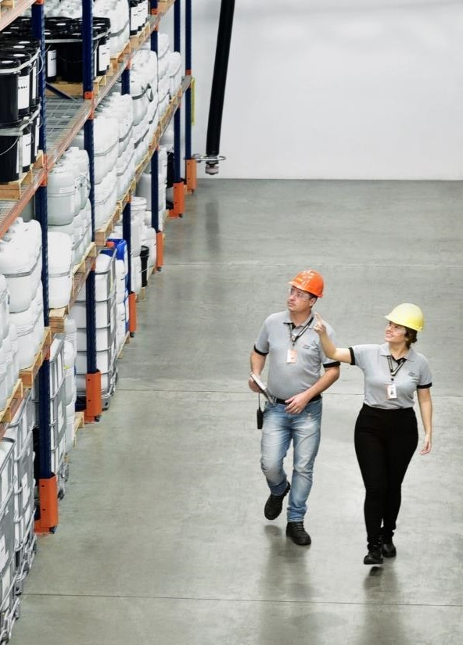
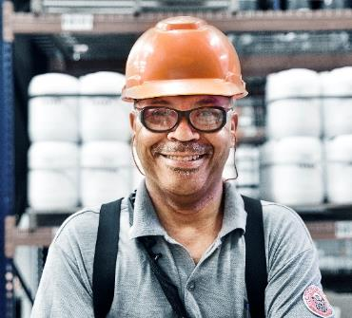
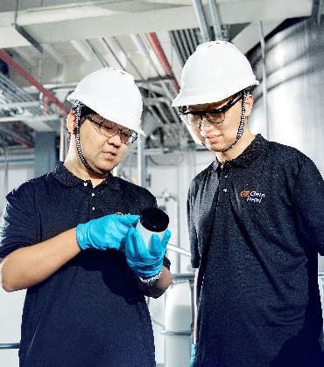

diversity
CHEM-TREND IS FOR YOU.
diversity
11

Slide 12
CHEM-TREND IS FOR YOU
We embrace diversity celebrating our differences under a culture of openness and respect everywhere in the world.
We believe that an inclusive and engaging workplace, where everyone belongs, empowers you to achieve your best self.
We value creativity and teamwork, delivering innovation with successful results for us and for our customers.
Together!
12

Slide 13
CHEM-trend fundamentals
History
Vision/
mission
Summary
Values
Culture
PEOPLE
Field of
business
Business
model

Slide 14
Why Chem-Trend Slides
The next several slides are created to explain what makes Chem-Trend different and give your audience insight into our thinking.
^{NOTE:} Do not use this slide. This is only meant for organization and explanation purposes.

Slide 15
Chem-Trend is the most proven partner in the world for release agents, purging compounds, and other process chemical specialties.

Slide 16
We help unleash:

Slide 17
Chem-Trend Fundamentals
These slides represent the basic information about Chem-Trend.
^{NOTE:} Do not use this slide. This is only meant for organization and explanation purposes.

Slide 18
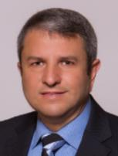
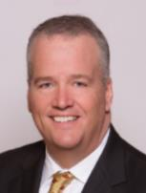
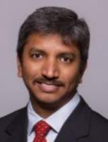

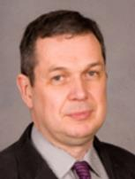
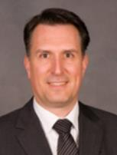




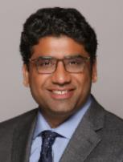
Global Executive Committee (GEC)
President & CEO
D. Moraes
30 Years of Service
Regional
Vice President Corporate Business Development
R. Nair
Hired 2019
Executive Vice President & CFO
C. Smith
14 Years of Service
Executive Vice President & COO
J. Graff
32 Years of Service
Executive Vice President Sales
B. Miller
29 Years of Service
Executive Vice President Marketing
& Technology
M. Psillakis
25 Years of Service
Vice President & G.M. - Asia Pacific
J. Lundin
17 Years of Service
Vice President & G.M. - North America
S. Hariharan
18 Years of Service
Global
Executive Finance
& Operations
Director Europe
M. Tenbrink
22 Years of Service
Executive Sales Director Europe
P. McGill
27 Years of Service
Vice President & G.M. - Southern
Hemisphere
P. Ajeje
1 Year of Service
Corporate Steering Committee (CSC): Devanir Moraes, Chandler Smith, Jim Graff

Slide 19
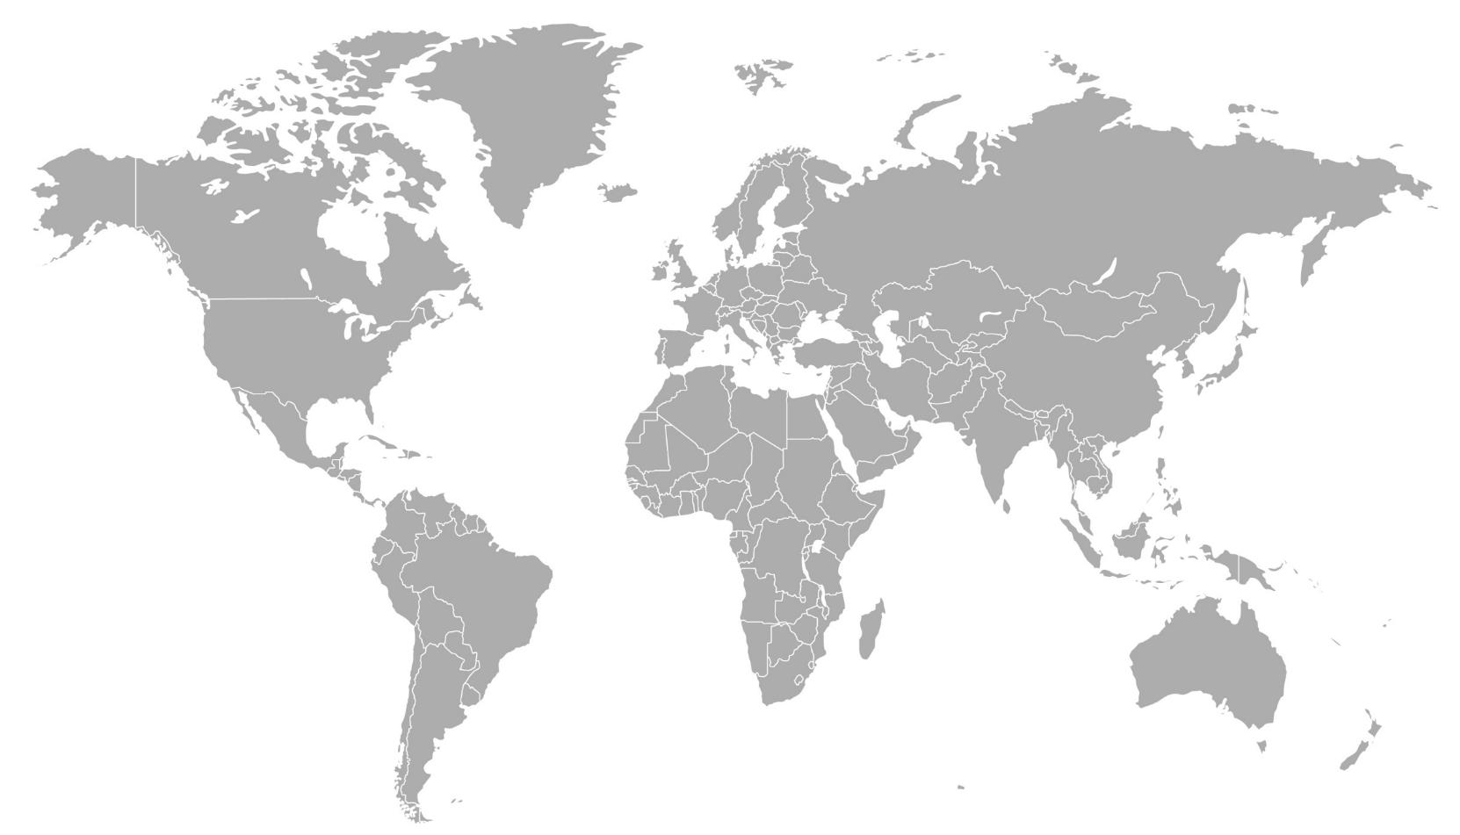
Global Reach with Local Presence
EUROPE
Maisach, Germany
AUSTRIA
CZECH REPUBLIC
DENMARK
FRANCE
GERMANY
ITALY
POLAND
ROMANIA
RUSSIA
SPAIN
SWEDEN
U.K.
ASIA PACIFIC
QINGPU, CHINA
AUSTRALIA
CHINA
INDONESIA
JAPAN
KOREA
SINGAPORE
THAILAND
VIETNAM
NORTH AMERICA
Howell, USA
Global HQ
USA
MEXICO
INDIA
Bangalore, India
LEGEND
LEGAL ENTITIES
OTHER PRESENCE
SOUTHERN HEMISPHERE
Valinhos, Brazil
Includes distribution network covering more than 60 countries

Slide 20
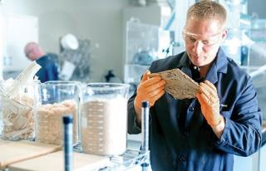


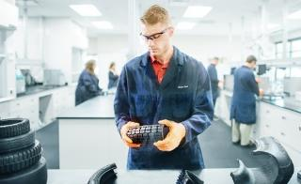
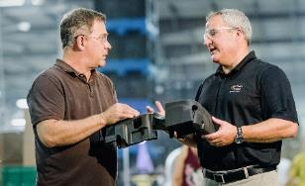
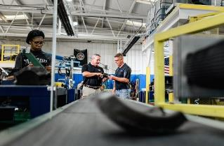

Diverse industry mix
WOOD COMPOSITE
THERMOPLASTICS
4%
7%
24%
DIE CAST
TIRE
26%
20%
POLYURETHANE
COMPOSITES
9%
10%
RUBBER
20

Slide 21

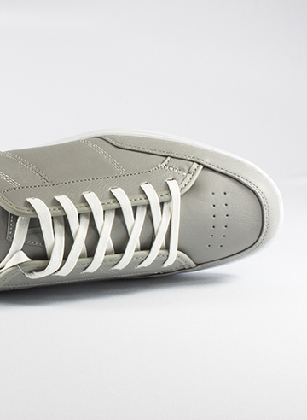








End User Market Diversification
AEROSPACE
CONSUMER GOODS
AUTOMOTIVE
ELECTRONICS
CONSTRUCTION
MEDICAL EQUIPMENT
PACKAGING
SPORTING GOODS
MARINE CRAFT
ENERGY

Slide 22
Chem-Trend Advantage Slides
The following slides are meant to convey major themes about how we work,
with impactful graphic elements.
^{NOTE:} Do not use this slide. This is only meant for organization and explanation purposes.

Slide 23
How we do it
Vast research and development facilities.

Slide 24
How we do it
Exceptional, experienced, and passionate people.

Slide 25
Sustainable
In our own work. And for our customers.
Reducing the impact of our activities on the environment.
Positively affecting our
customers’ impact on the environment.
We’ve been creating sustainable solutions
and progress since day one, focused on
Five areas of continual improvement:
25

Slide 26

Sustainable
In our own work. And for our customers.
Ways We Minimize our Footprint
Promoting more recycling
Improving energy efficiency
Continuing to shift toward local sourcing of raw materials and local production
Using more environmentally responsible materials
Reducing waste
Ways We Maximize our Handprint
Improved productivity
  More good parts per hour
  Reduction in labor intensity
Reduced VOC emissions
Reduced waste, scrap, and rework
Safer, more environmentally responsible products
Developing tools to better communicate sustainability impact to customers
26

Slide 27

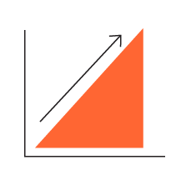


Innovative
To create every advantage.
DISCOVERING NEW EFFICIENCY
IMPROVING CUSTOMER PRODUCT QUALITY
DIGITALIZATION INITIATIVES
CUSTOMIZATION FOR EACH UNIQUE SITUATION

Slide 28
R&D PLANNING
PERSONNEL
Innovation
Strategic approach in six key areas.
IP PROTECTION
R&D PLANNING
Diverse Product Portfolio, Short & Long Term Projects
PERSONNEL
Expert Retention & Enrichment
IP PROTECTION
IP Culture, Policies, & Systems
SUPPLY CHAIN
Alternative Sourcing & Localization
SUSTAINABILITY
Minimized Footprint & Maximized Handprint
MARKETING
Brand Leadership & Communications
SUPPLY CHAIN
SUSTAIN-ABILITY
MARKETING

Slide 29
Digitalization
Key initiative built with a strategic mindset.
Utilizes cross-functional, cross-regional teams to build global solutions
Maximizes synergies with FCS
(Chem-Trend Now, Product Application Monitoring, Online Shop)
Builds on existing tools (C4C, Chem-Trend Now, DilutionIQ™);
Uses shared, open platforms (SAP, Azure)
Fast-paced development to stay ahead of competition
and to provide stream of new tools
Digitalization Steering Committee sets goals and objectives

Slide 30
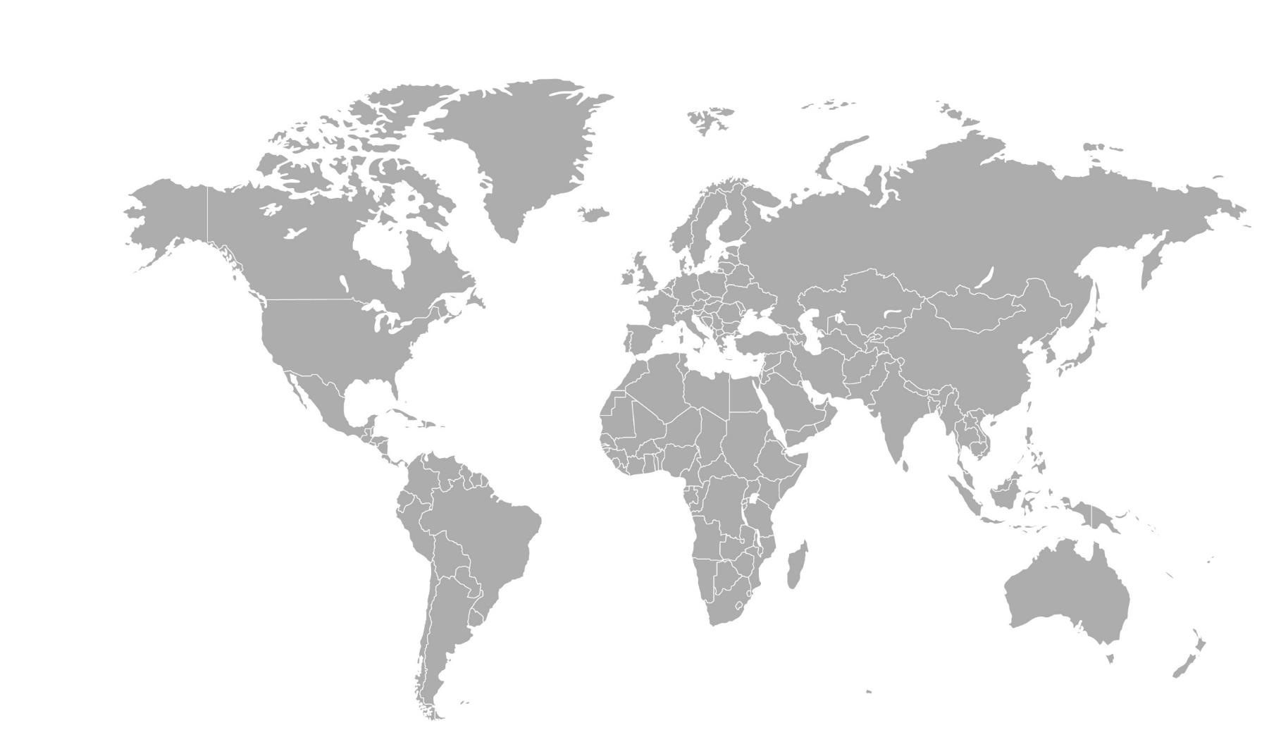

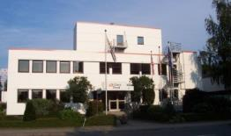
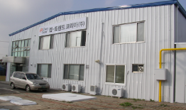
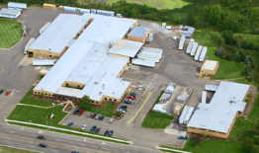
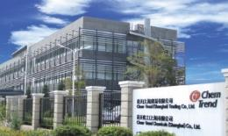
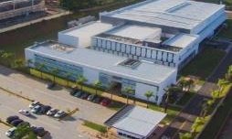
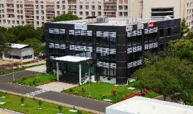
OPERATIONS
FOOTPRINT
HOWELL (MP), U.S.
NORDERSTEDT, GERMANY
ANSEONG, S. KOREA
HOWELL (GR), U.S.
QINGPU, CHINA
VALINHOS, BRAZIL
MYSORE, INDIA

Slide 31
Operational Excellence
Aspiration to lead in every market we serve.
Embraces problem solving and leadership as key elements for continuous improvement.
Sees the flow of value to the customer and understands our role within it.
Strives to do the right thing at the right time every time.
Uses various methodologies including lean, six sigma, and kaizen to improve our products and services.
Aims to eliminate one or more of the 7 forms of waste:
OVER-PRODUCTION
OVER-PROCESSING
INVENTORY
TRANSPORT
DEFECTS
MOTION
WAITING

Slide 32
Affiliations Slides
These slides are used to explain our strength and scope due to our corporate relationships.
^{NOTE:} Do not use this slide. This is only meant for organization and explanation purposes.

Slide 33
A part of , providing
Strength
Scale
And confidence

Slide 34

Family-owned with a 170-year history
Global presence in more than 50 countries, with business groups focused on multiple business sectors
Sales over 9 billion Euro
Over 47,000 employees worldwide
Commitment to a customer-focused philosophy
Chem-Trend’s customers benefit through:
  Our long-term stability supported by Freudenberg’s financial strength
  Our access to additional research, development, and innovation pipelines
  Our ability to rely on a supportive structure focused on business integrity, diversity, quality, and reliability

Slide 35






Freudenberg Chemical
Specialties
High degree of specialization and strong brands
Focus on innovation
Global reach with simultaneous local support capabilities
SPECIALTY LUBRICANTS
SPECIAL RELEASE AGENTS
HIGH-PERFORMANCE LUBRICANTS
SURFACE AND ELECTRO-PLATING TECHNOLOGIES
SPECIALTY COATINGS
FOR THE CONFECTIONERY INDUSTRY
Delete this text box before use.
This slide does not have animations
Notes:
Slide with no animation

Slide 36
Freudenberg Chemical
Specialties
High degree of specialization and strong brands
Focus on innovation
Global reach with simultaneous local support capabilities
SPECIALTY LUBRICANTS
SPECIAL RELEASE AGENTS
HIGH-PERFORMANCE LUBRICANTS
SURFACE AND ELECTRO-PLATING TECHNOLOGIES
SPECIALTY COATINGS
FOR THE CONFECTIONERY INDUSTRY
Focus on OEM
Customer specific
Global direct sales
Components
Focus on operators
Industry application specific
Global direct sales
Consumables
Focus on distribution
Standardized products
Global direct sales
Maintenance/repair
Focus on operators
System dependant
Global direct sales
Process components
Focus on operators
System dependant
Global direct sales
Conditioning additives
Delete this text box before use.
This slide uses animations to reveal each company’s specialties..
Notes:
Slide with Animation

Slide 37
Industry Solutions Slides
The following slides describe our industry segments, solutions, and brands.
They are meant to give our customers a sense of breadth and completeness.
^{NOTE:} Do not use this slide. This is only meant for organization and explanation purposes.

Slide 38


Die Cast
Our Solutions
DIE LUBRICANTS/RELEASE AGENTS
PLUNGER LUBRICANTS
ANCILLARY PRODUCTS
Our Brands
CHEM-TREND®

Slide 39




Composites
Our Solutions
RELEASE AGENTS
SEMI-PERMANENT
CONVENTIONAL
INTERNAL
CLEANERS
PRIMERS
SEALERS
Our Brands
CHEMLEASE®
ZYVAX®

Slide 40
Polyurethane
Our Solutions
RELEASE AGENTS
ANCILLARY PRODUCTS
Our Brands
CHEM-TREND®

Slide 41
Rubber
Our Solutions
SEMI-PERMANENT
RELEASE AGENTS
CONVENTIONAL
RELEASE AGENTS
MOLD PROTECTORS
MANDREL LUBRICANTS
Our Brands
MONO-COAT®

Slide 42
Tire
Our Solutions
INSIDE TIRE PAINTS
OUTSIDE TIRE PAINTS
TIRE CURING BLADDER COATINGS
RELEASE AGENTS FOR TIRE
RETREADING APPLICATIONS
MOLD COATINGS
Our Brands
CHEM-TREND®

Slide 43
Thermoplastics
Our Solutions
PURGING COMPOUNDS
MOLD MAINTENANCE PRODUCTS
MOLD RELEASE AGENTS
Our Brands
LUSIN®
ULTRA PURGE™

Slide 44
Wood Composite
Our Solutions
BELT SPRAY
MAT SPRAY
CAUL SPRAY
PLATTEN COATING
ROLLER SPRAY
Our Brands
CHEM-TREND®

Slide 45
Additional Slide Images
The following slides are additional orange overlay images.
^{NOTE:} Do not use this slide. This is only meant for organization and explanation purposes.

Slide 50
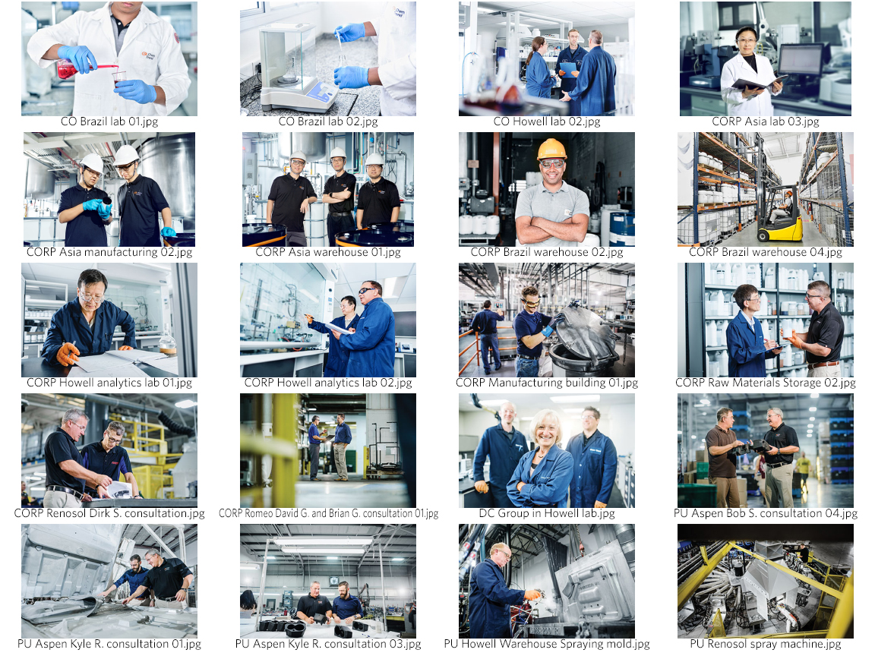
Additional
Dam images
These images are some examples that can be found on the DAM.
The image name is under each image.
Use the image name to search for them on the DAM.
Click to view on the DAM

